Slide 1
Washburn Family Jeopardy!
Business | Places | Washburn Women | Politics | Random
100 | 100 | 100 | 100 | 100
200 | 200 | 200 | 200 | 200
300 | 300 | 300 | 300 | 300
400 | 400 | 400 | 400 | 400
500 | 500 | 500 | 500 | 500

Slide 2
Business - 100 - Question
What was the name of Algernon Sidney Washburn’s store in Boston?
a. Hometown Store
b. Shaw and Washburn
c. Washburn Penny
d. Boston Hardware
Click to see the answer 🙌

Slide 3
Business - 100 - Answer
Shaw and Washburn
Go back to the board 🏆

Slide 4
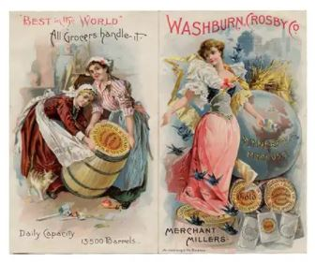
Business - 200 - Question
What was the name of Cadwallader Washburn’s flour company?
a. King Arthur Flour
b. Cadwallader Flour
c. Gold Medal Flour
d. Silver Wheat Flour
Click to see the answer 🙌

Slide 5
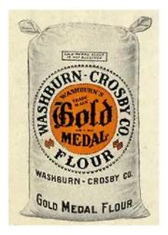
Business - 200 - Answer
Gold Medal Flour
Go back to the board 🏆

Slide 6
Business - 300 - Question
Israel Washburn Jr. became president of an organization that specialized in this type of popular transportation:
a. Airplane
b. Railroad
c. Automobile
d. Steamboat
Click to see the answer 🙌

Slide 7
Business - 300 - Answer
Railroad
Go back to the board 🏆

Slide 8
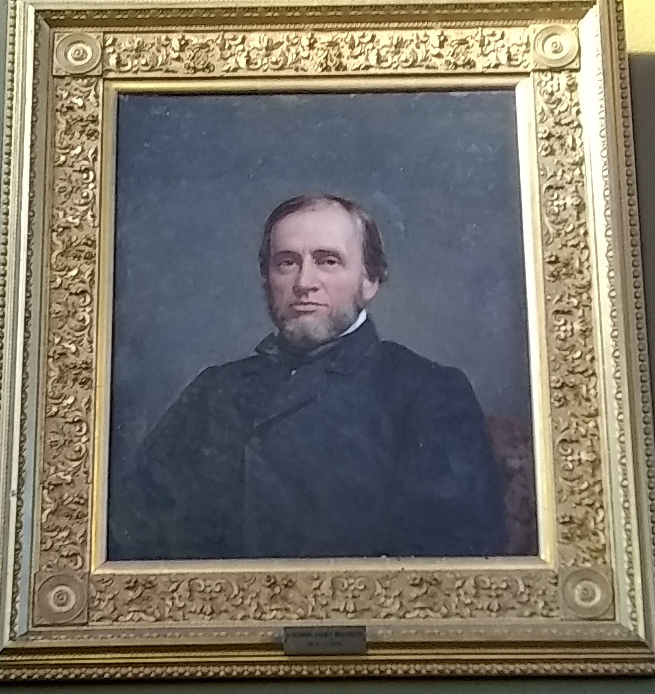
Business - 400 - Question
Algernon Sidney Washburn organized the First National Bank of _____:
a. Hallowell
b. Livermore
c. Farmington
d. Skowhegan
Click to see the answer 🙌

Slide 9
Business - 400 - Answer
Hallowell
Go back to the board 🏆

Slide 10
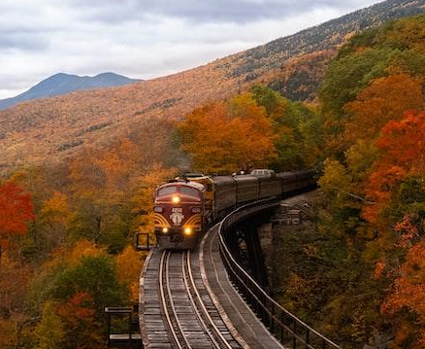
Business - 500 - Question
What railroad company did William Drew Washburn found?
a. Short Line Railroad
b. B & O Railroad
c. Pennsylvania Railroad
d. SOO Railroad
Click to see the answer 🙌

Slide 11
Business - 500 - Answer
The SOO Railroad Company
Go back to the board 🏆

Slide 12
Places - 100 - Question
Which town did Israel Washburn Sr. move to Livermore from?
a. Portland, Maine
b. Danbury, Connecticut
c. Raynham, Massachusetts
d. Brattleboro, Vermont
Click to see the answer 🙌

Slide 13
Places - 100 - Answer
Raynham, Massachusetts
Go back to the board 🏆

Slide 14
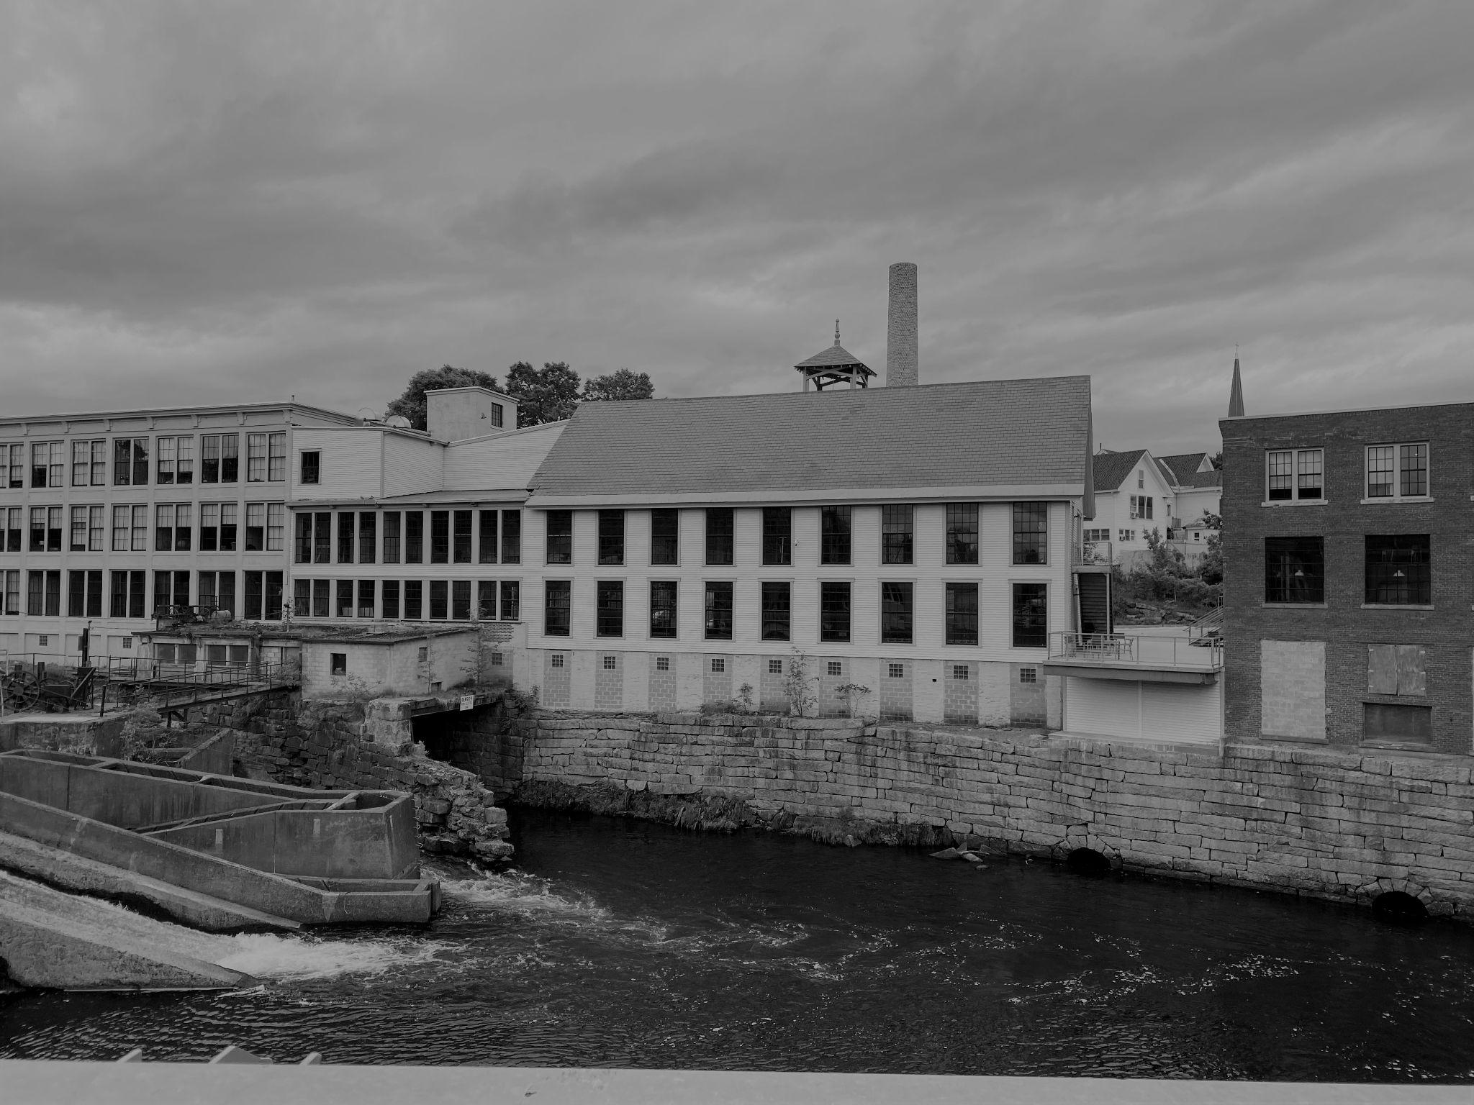
Places - 200 - Question
The youngest Washburn sibling, Caroline Washburn Holmes, settled in this area of Maine that used to be two separate towns:
a. Bangor
b. Dover-Foxcroft
c. Portland
d. Livermore Falls
Click to see the answer 🙌

Slide 15
Places - 200 - Answer
Dover-Foxcroft
Go back to the board 🏆

Slide 16
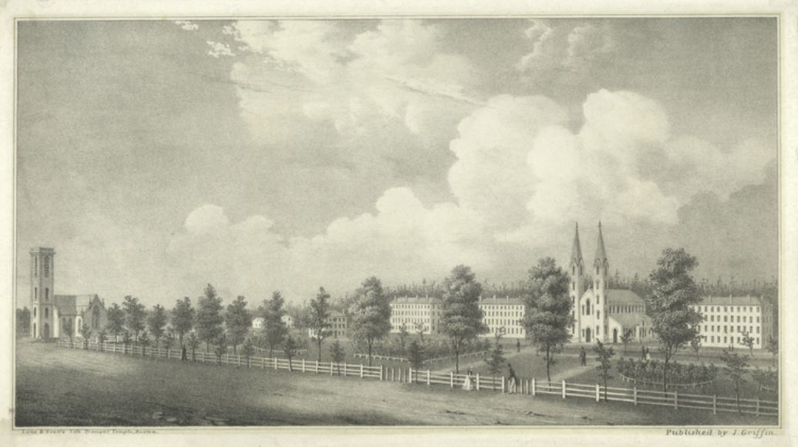
Places - 300 - Question
Which Maine college did William Drew Washburn graduate from?
a. Colby College
b. Dartmouth College
c. Bowdoin College
d. Yale University
Click to see the answer 🙌

Slide 17
Places - 300 - Answer
Bowdoin College
Go back to the board 🏆

Slide 18
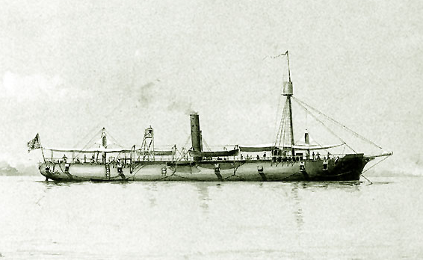
Places - 400 - Question
What was the name of the gunboat Samuel Washburn captained?
a. The Galena
b. The Good Ship
c. U.S.S. Washburn
d. The Maine
Click to see the answer 🙌

Slide 19
Places - 400 - Answer
The Galena
Go back to the board 🏆

Slide 20
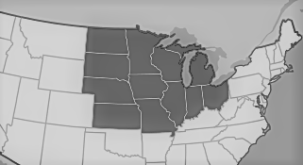
Places - 500 - Question
During her final years, Martha Washburn Stephenson lived in this northern-most state:
a. Tennessee
b. Florida
c. North Dakota
d. North Carolina
Click to see the answer 🙌

Slide 21
Places - 500 - Answer
North Dakota
Go back to the board 🏆

Slide 22
Washburn Women - 100 - Question
From 1814 - 1833, Martha “Patty” Benjamin Washburn had many children. How many children did she have?
a. 2
b. 5
c. 8
d. 10
Click to see the answer 🙌

Slide 23
Washburn Women - 100 - Answer
10 children
Go back to the board 🏆

Slide 24
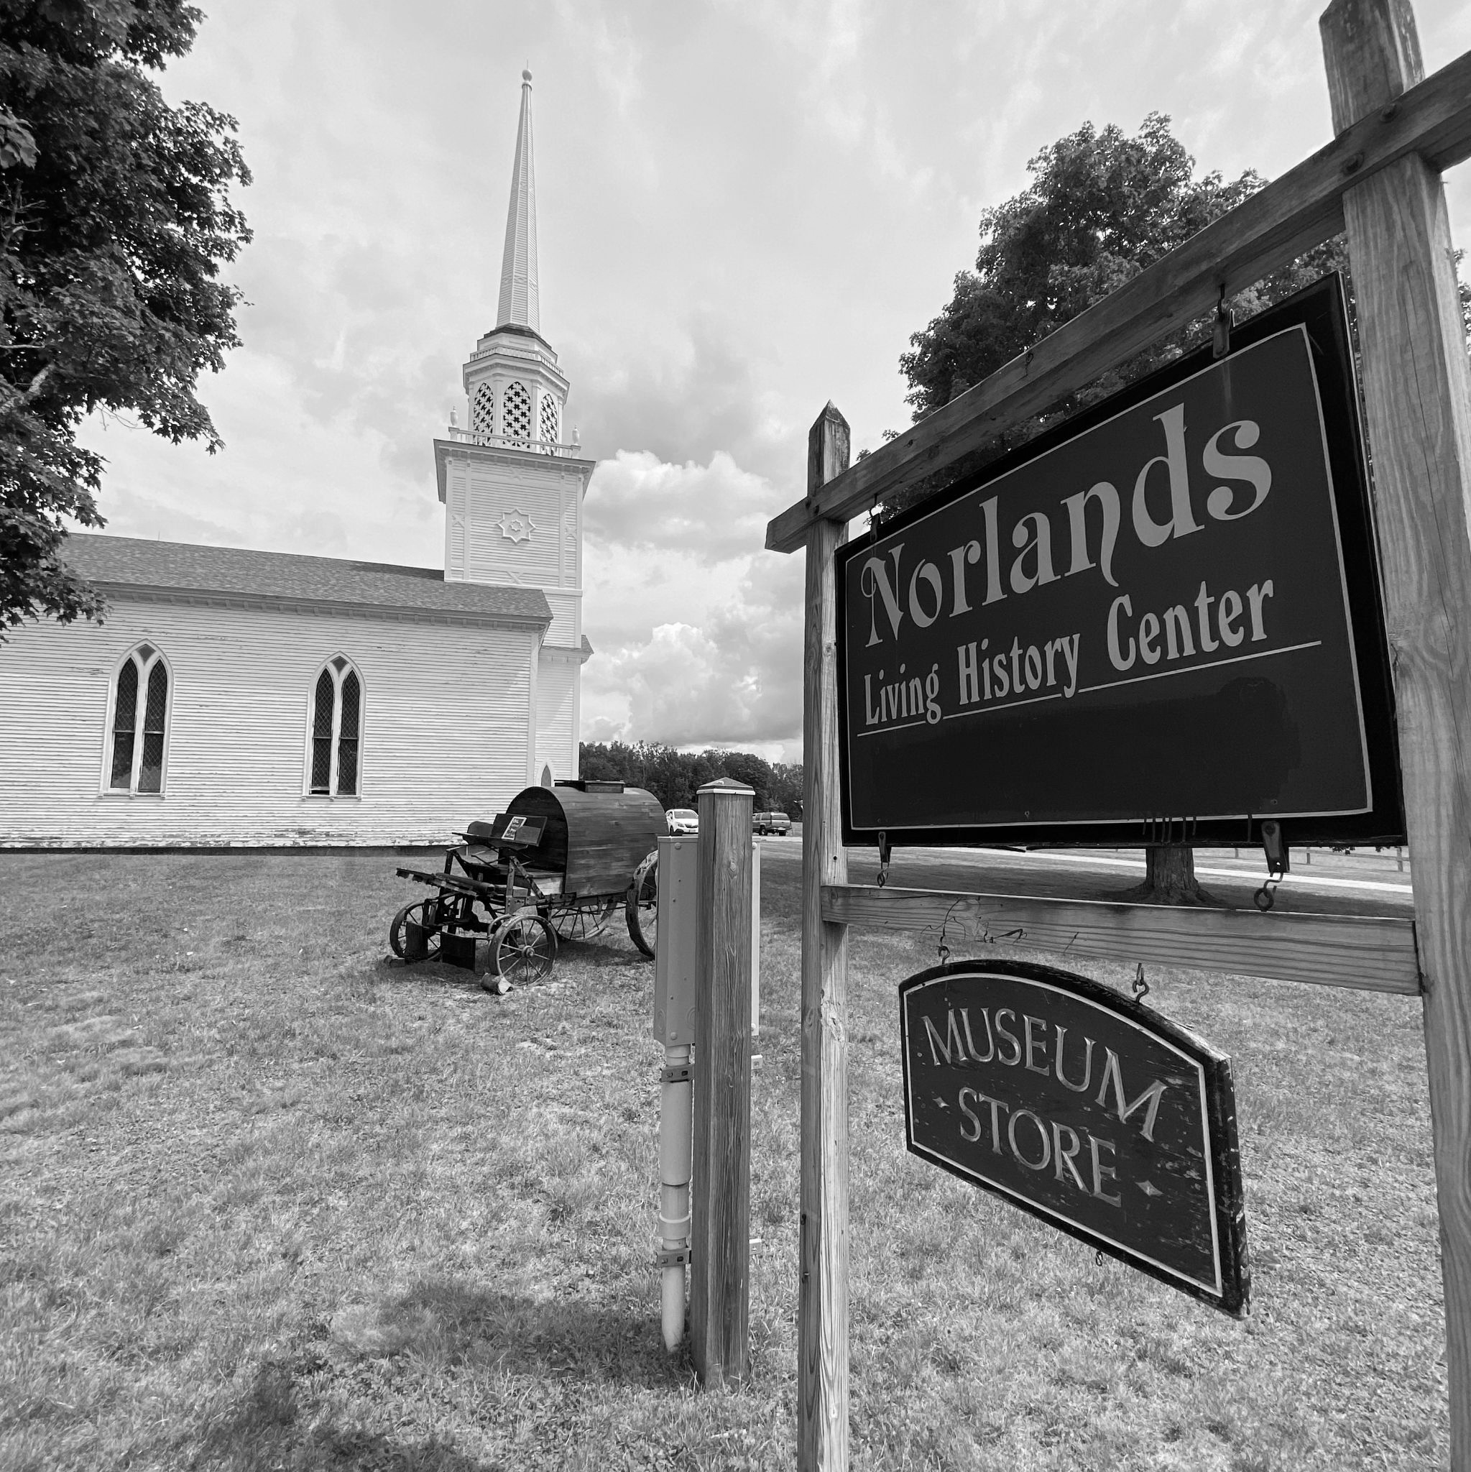
Washburn Women - 200 - Question
Martha “Patty” Benjamin Washburn’s family were the founders of which Maine town?
a. Livermore
b. Augusta
c. Bangor
d. Rockland
Click to see the answer 🙌

Slide 25
Washburn Women - 200 - Answer
Livermore, Maine
Go back to the board 🏆

Slide 26
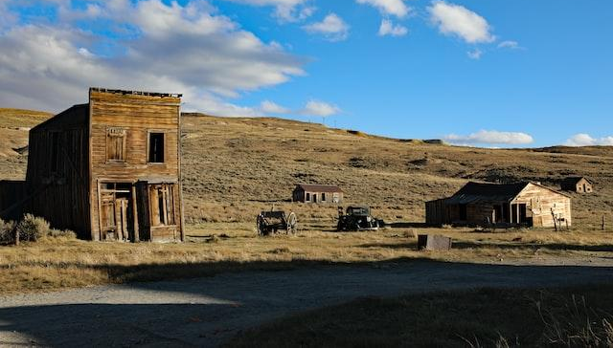
Washburn Women - 300 - Question
Mary Washburn Buffum had to wait 8 years for her husband to return from working the 'Gold Rush' - where did he go to pan for gold?
a. Texas
b. California
c. Georgia
d. Kentucky
Click to see the answer 🙌

Slide 27
Washburn Women - 300 - Answer
California
Go back to the board 🏆

Slide 28
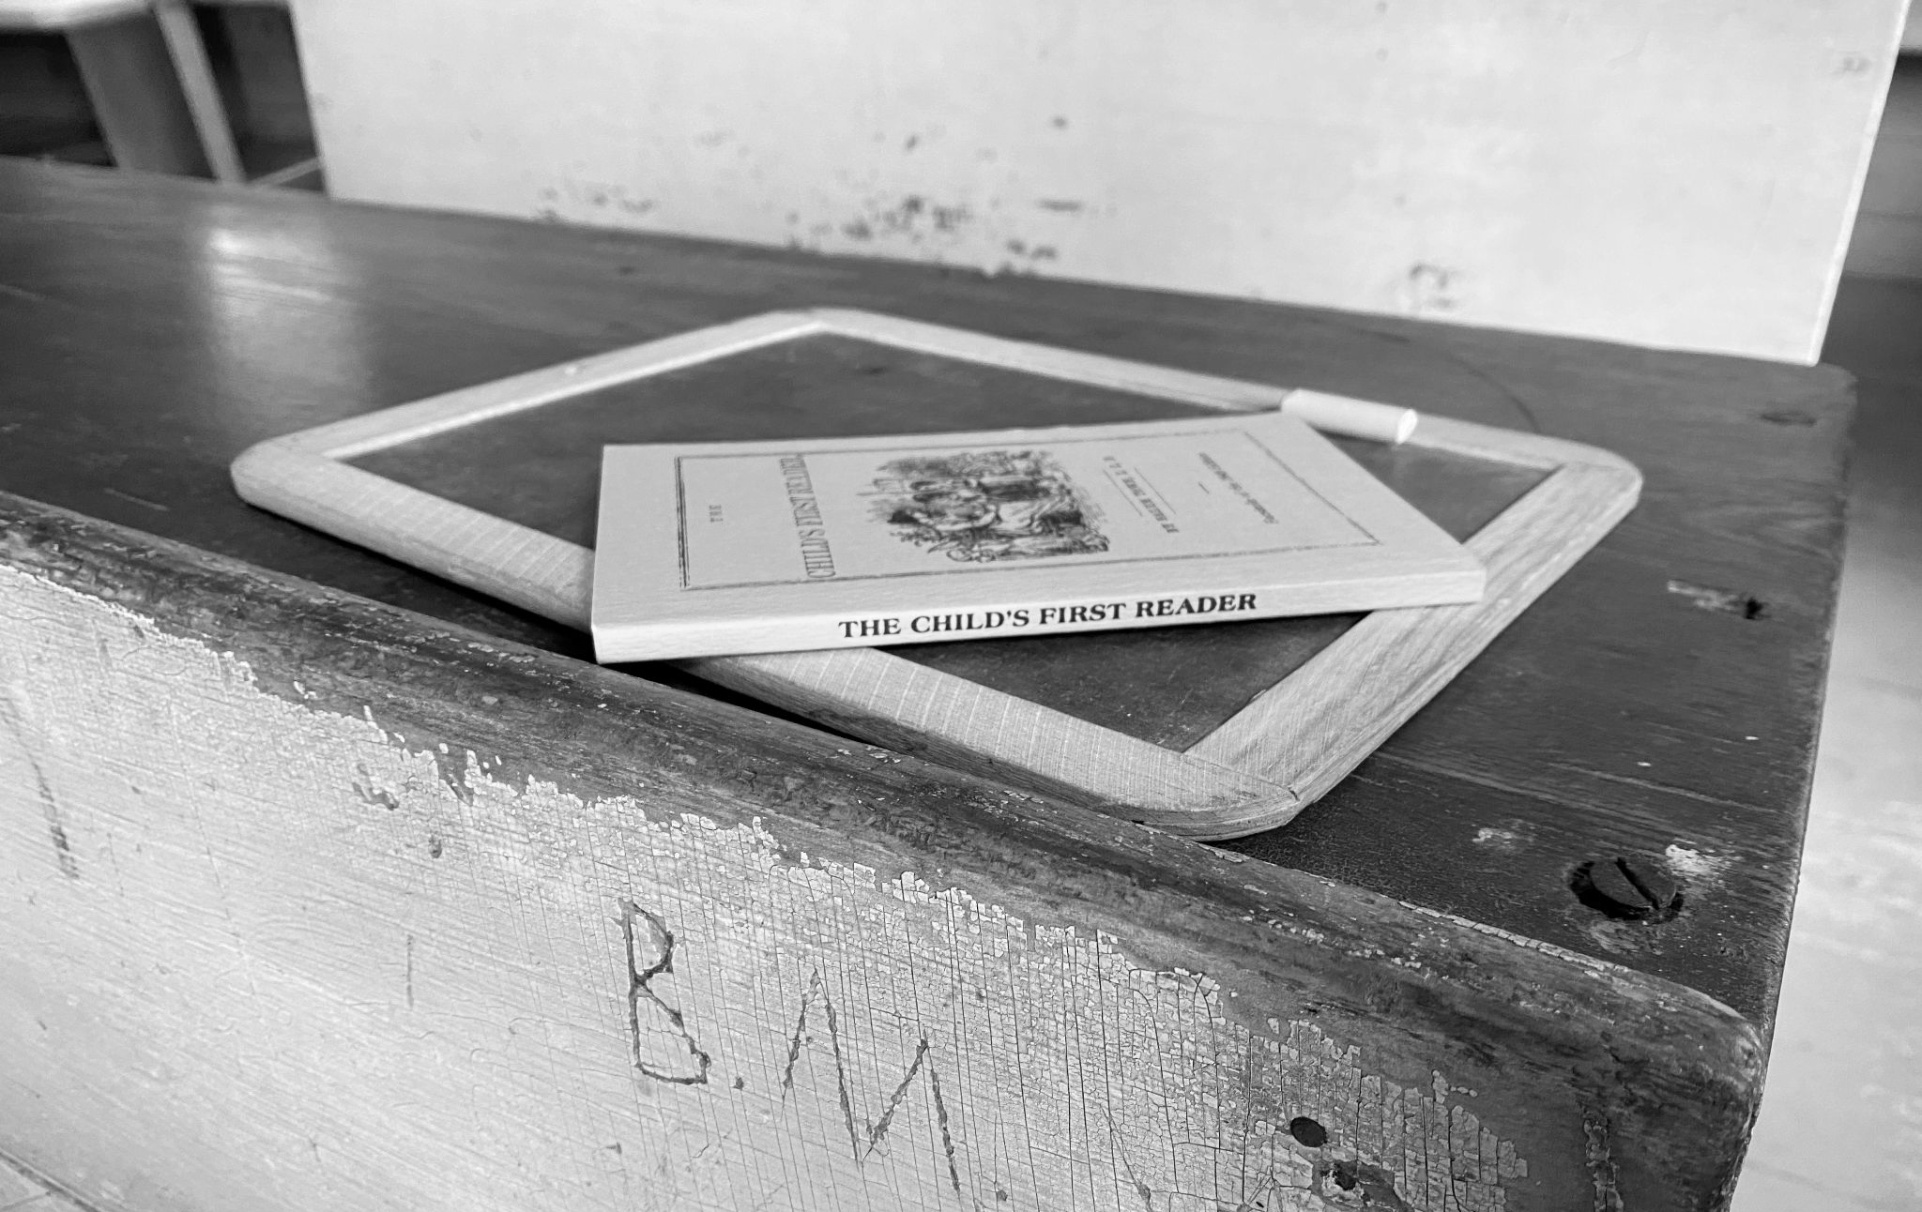
Washburn Women - 400 - Question
Martha Washburn Stephenson attended The Waterville Liberal Institute to train for this job:
a. Baker
b. Nurse
c. Farmer
d. Teacher
Click to see the answer 🙌

Slide 29
Washburn Women - 400 - Answer
Teacher
Go back to the board 🏆

Slide 30
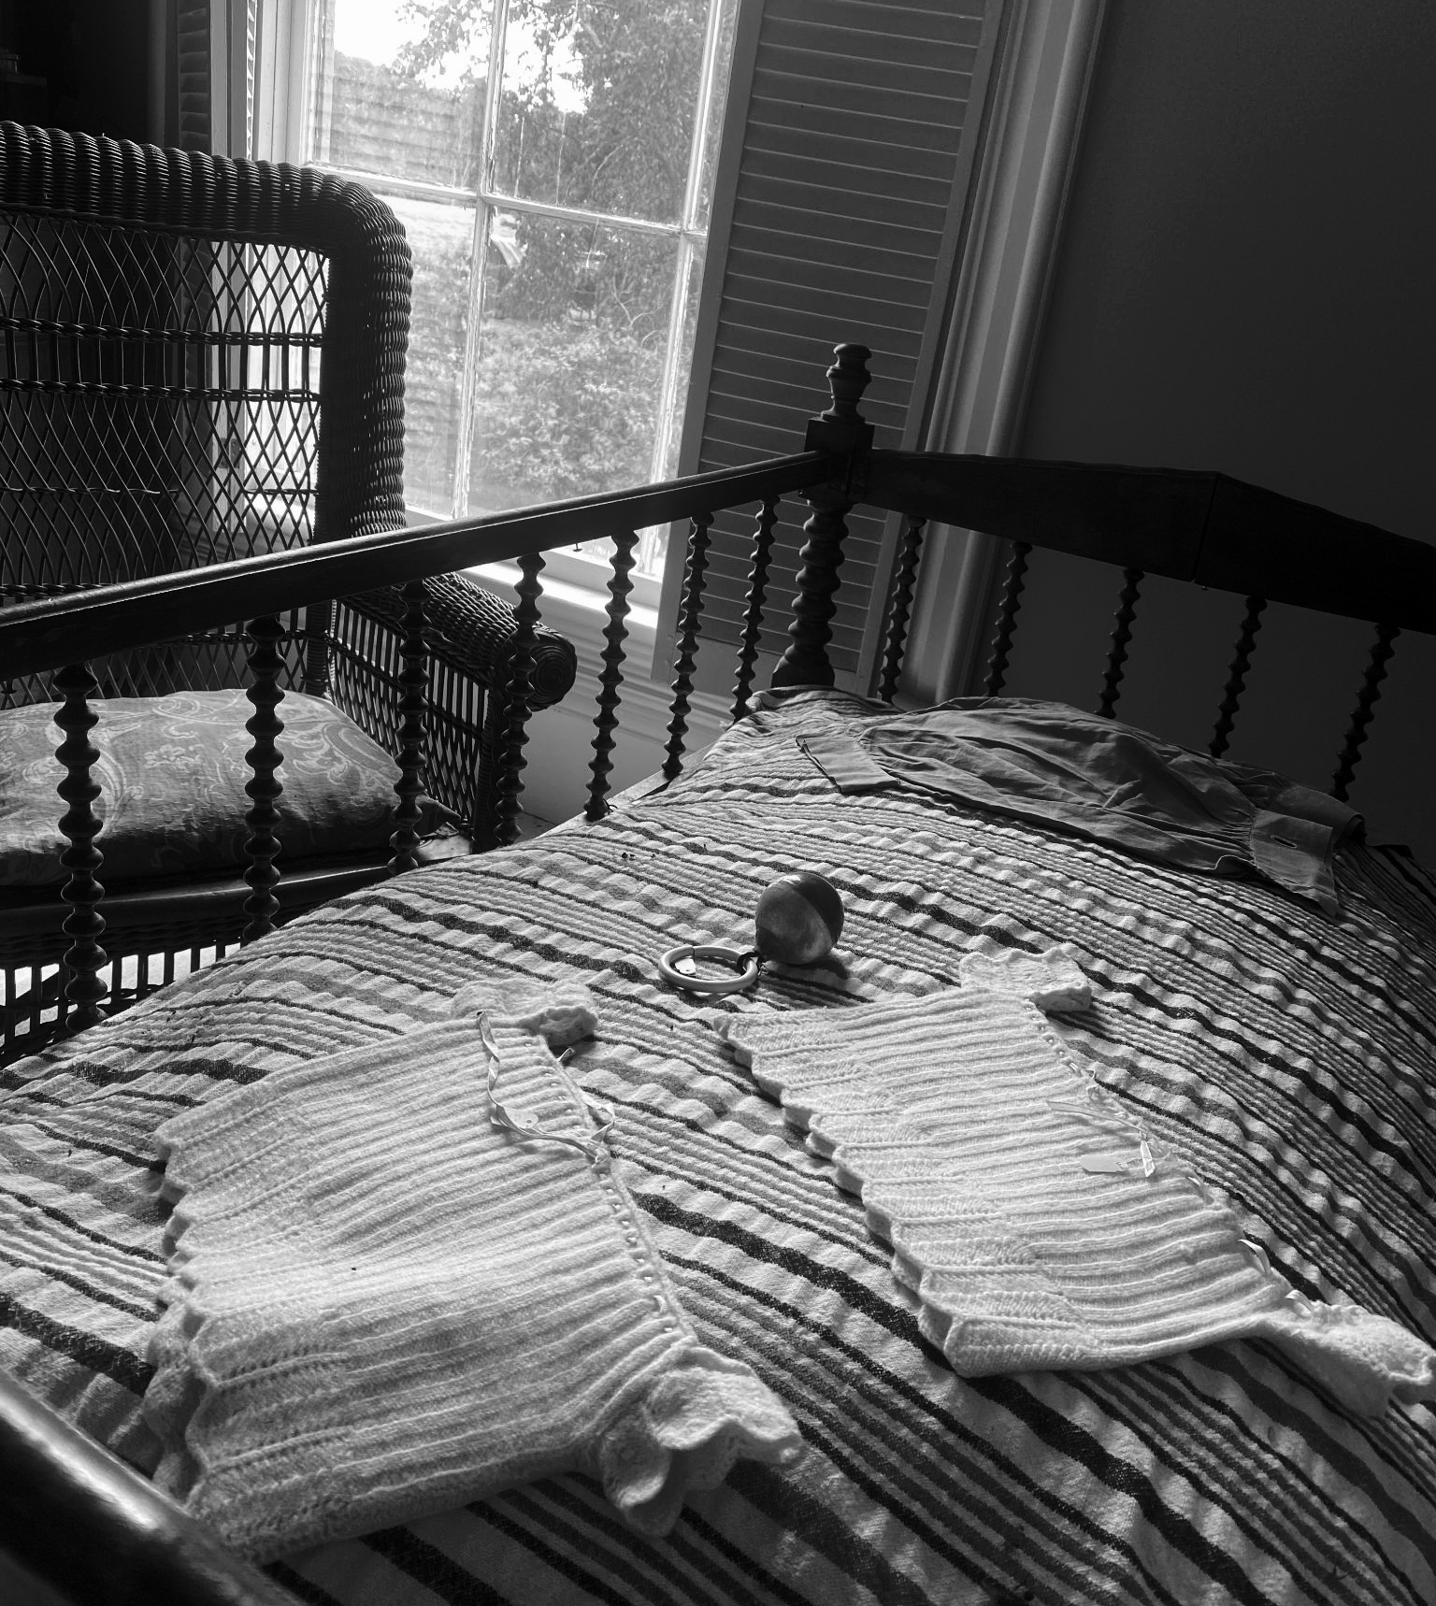
Washburn Women - 500 - Question
How did Mary Washburn Buffum die?
a. A deadly flu
b. Anesthesia given to her
during childbirth
c. Horse carriage accident
d. Natural causes
Click to see the answer 🙌

Slide 31
Washburn Women - 500 - Answer
Anesthesia given to her during childbirth
Go back to the board 🏆

Slide 32
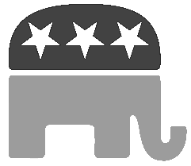
Politics - 100 - Question
What political party did Israel Washburn Jr. have influence in forming?
a. Republican Party
b. Democratic Party
c. Whig Party
d. Independent Party
Click to see the answer 🙌

Slide 33
Politics - 100 - Answer
The Republican Party
Go back to the board 🏆

Slide 34
Politics - 200 - Question
Which two presidents was Elihu Washburne friends with?
a. Ulysses S. Grant
b. George Washington
c. Franklin Roosevelt
d. Abraham Lincoln
Click to see the answer 🙌

Slide 35
Politics - 200 - Answer
President Abraham Lincoln and President Ulysses S. Grant
Go back to the board 🏆

Slide 36
Politics - 300 - Question
Which Midwest state was Cadwallader Washburn governor of?
a. California
b. Alaska
c. Wisconsin
d. New York
Click to see the answer 🙌

Slide 37
Politics - 300 - Answer
Wisconsin
Go back to the board 🏆

Slide 38
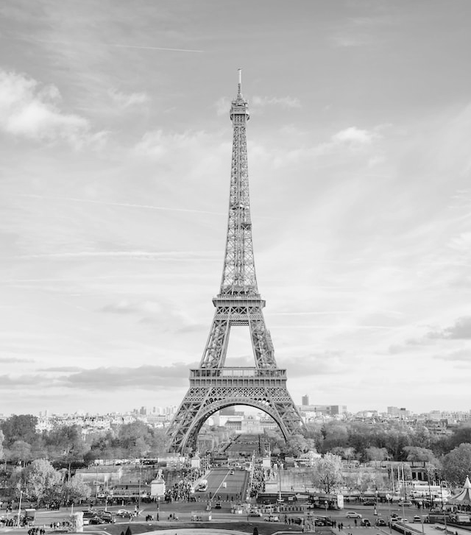
Politics - 400 - Question
What country did Elihu Washburne serve in as the Foreign Minister?
a. Germany
b. France
c. England
d. Brazil
Click to see the answer 🙌

Slide 39
Politics - 400 - Answer
France
Go back to the board 🏆

Slide 40
Politics - 500 - Question
What was Elihu Washburne known as while he was in Congress?
a. The Speaker in the Chair
b. The Father of the House
c. The Watchdog of the Treasury
d. The Man with the Plan
Click to see the answer 🙌

Slide 41
Politics - 500 - Answer
“The Father of the House” or “The Watchdog of the Treasury”
Go back to the board 🏆

Slide 42
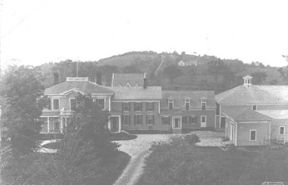
Random - 100 - Question
Who previously owned the Livermore farm that Israel Sr. would come to buy?
a. Abraham Lincoln
b. George Washington
c. Dr. Cyrus Hamlin
d. Jefferson Frye
Click to see the answer 🙌

Slide 43
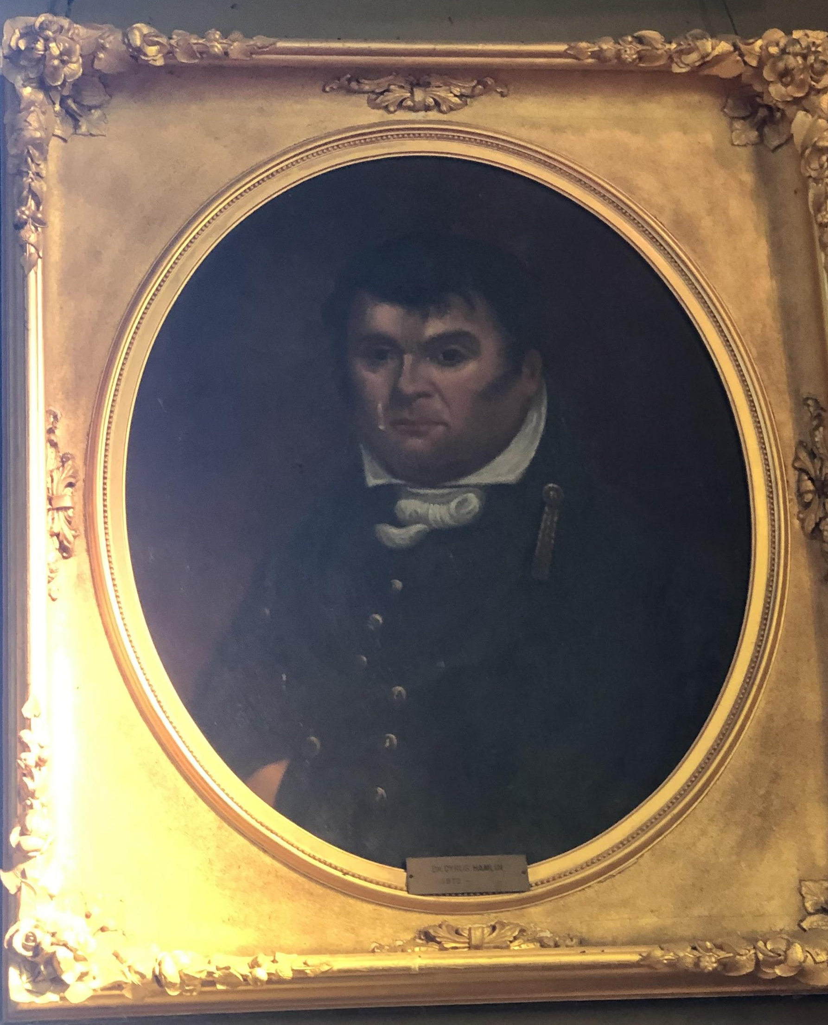
Random- 100 - Answer
Dr. Cyrus Hamlin (father of Vice President Hannibal Hamlin)
Go back to the board 🏆

Slide 44
Random - 200 - Question
What age did Samuel Washburn leave home to start a life at sea?
a. 18
b. 25
c. 32
d. 40
Click to see the answer 🙌

Slide 45
Random- 200 - Answer
18 years old
Go back to the board 🏆

Slide 46
Random - 300 - Question
What medical job did Caroline Washburn Holmes’ husband do for the Union Army during the Civil War?
a. Cannon Operator
b. Secret Spy
c. Band Leader
d. Surgeon
Click to see the answer 🙌

Slide 47
Random- 300 - Answer
Surgeon
Go back to the board 🏆

Slide 48
Random - 400 - Question
William Drew Washburn had a flour company that merged with this other company that has a Doughboy as their mascot:
a. Kraft
b. Pepsi
c. Cheetos
d. Pillsbury
Click to see the answer 🙌

Slide 49
Random- 400 - Answer
Pillsbury
(The Pillsbury Flour Company)
Go back to the board 🏆

Slide 50
Random - 500 - Question
What was the highest rank Cadwallader Washburn held while in the army during the Civil War?
a. Private
b. Major General
c. Staff Sergeant
d. Captain
Click to see the answer 🙌

Slide 51
Random- 500 - Answer
Major General
Go back to the board 🏆

